Slide 1

Task catalyst
Oral Presentation 2 – Software Demo
Notes:
NOTE: Want a different image on this slide? Select the picture and delete it. Now click the Pictures icon in the placeholder to insert your own image.

Slide 2
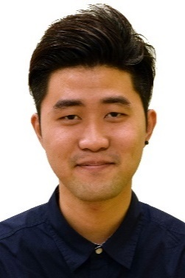
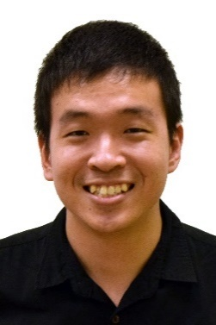
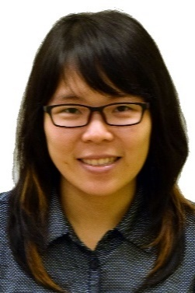
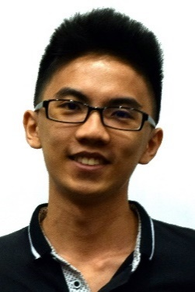
Introduction
Zhen Yu
Kelvin
Thida
Wei Jie
Introduction
Software Features
Software Demonstration
Software Demonstration

Slide 3
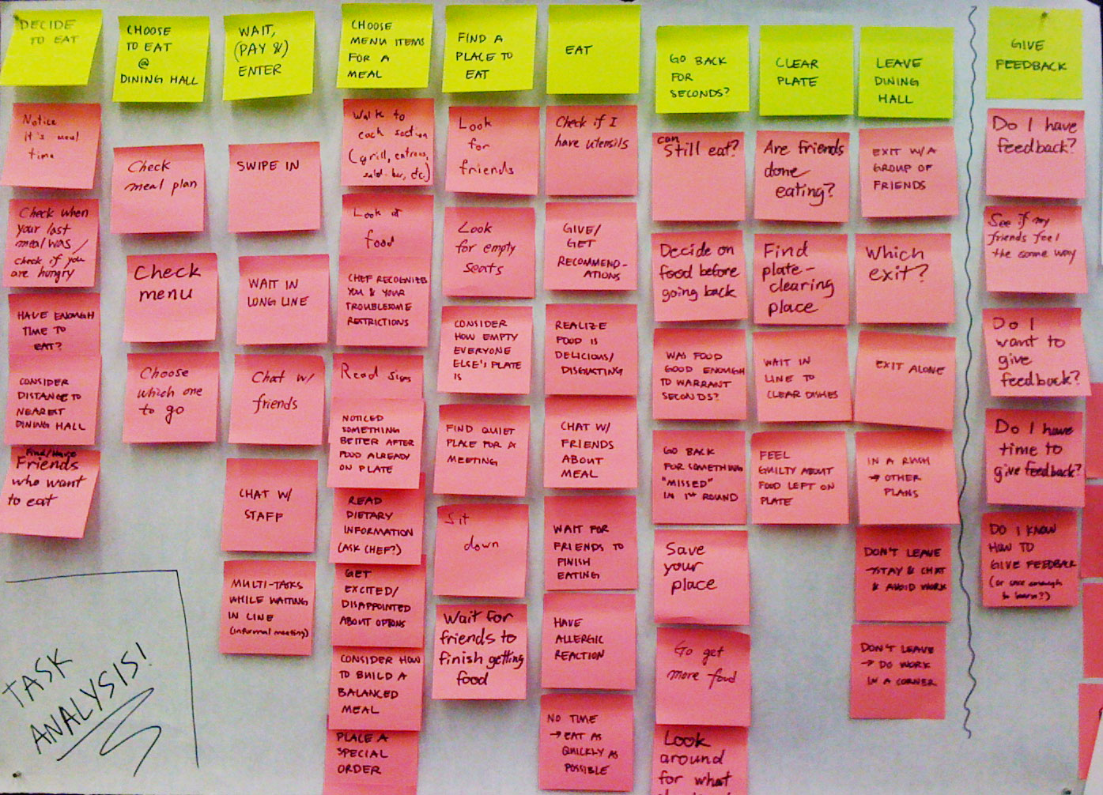
Introduction
Having a lot of tasks to do?

Slide 4
Introduction
Having difficulty keeping track of the tasks?

Slide 5

Introduction
Have you often miss your deadline?

Slide 6
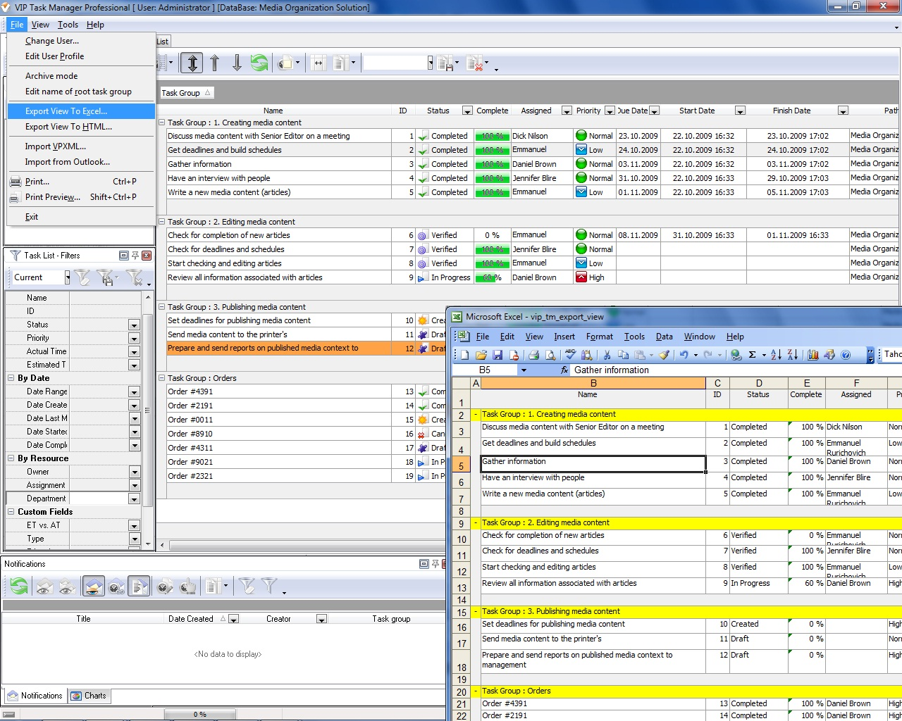
Introduction
Do you find other software complicated?

Slide 7
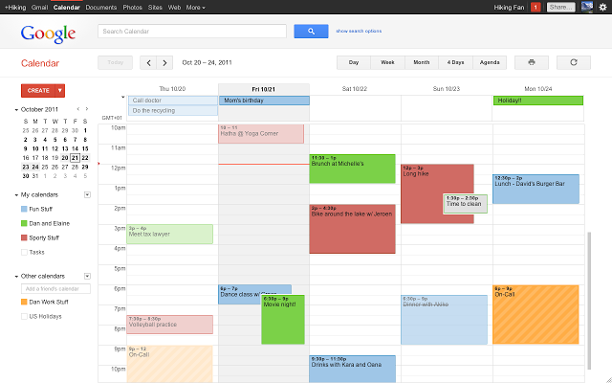

Introduction
Have you ever tried using google calander?

Slide 8

Introduction
Are you always on your laptop or computer?

Slide 9

Introduction
Do you use keyboard more than your mouse?

Slide 10
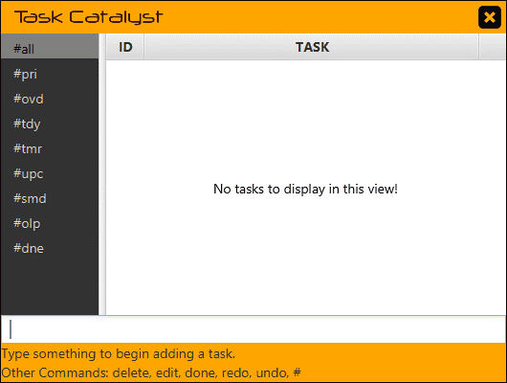
Introduction
We have found a solution!

Slide 11
SOFTWARE FEATURES

Slide 12


Software Features
Keep things in view.

Slide 13


Software Features
Never miss a deadline.

Slide 14
Software Features
Remember every single date.

Slide 15
Software Features
Know how long it takes.

Slide 16
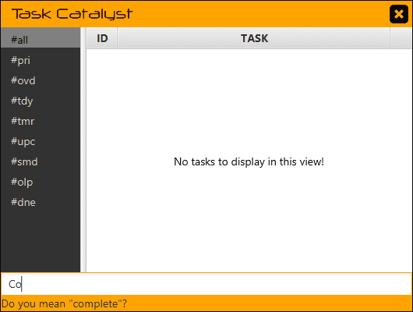
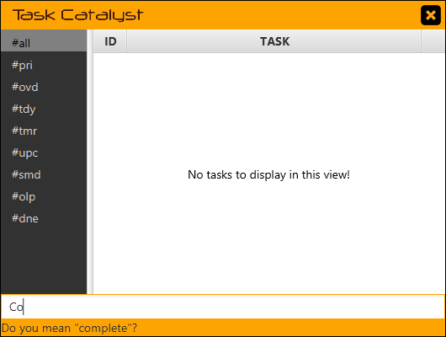
Software Features
Simplify the complex.

Slide 17
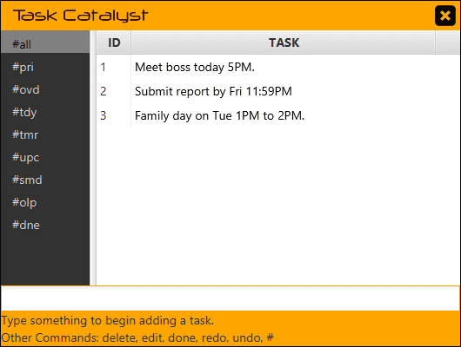
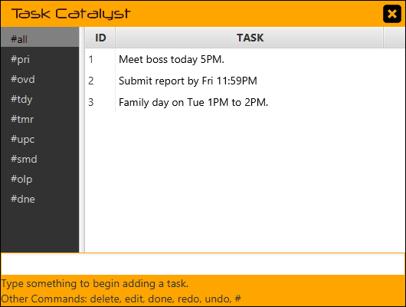
Software Features
Focus on the task.

Slide 18


Software Features
Find the right words.

Slide 19
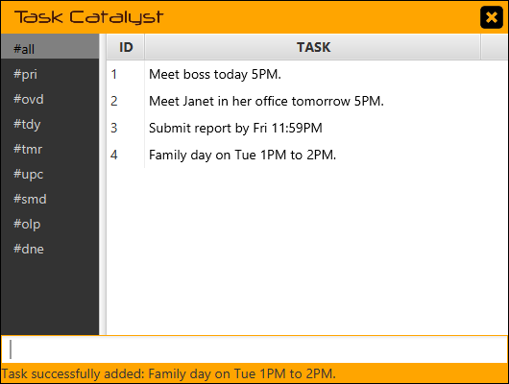
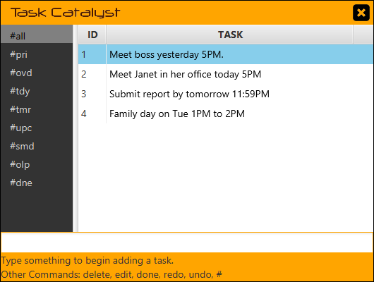
Software Features
Stay current.

Slide 20


Software Features
Get things done.

Slide 21
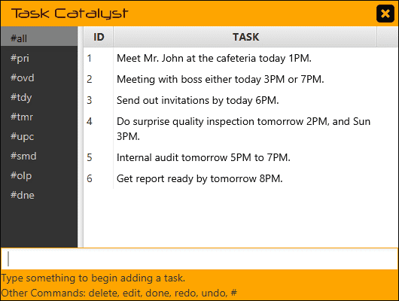

Software Features
One thing at a time.

Slide 22


Software Features
Make smart decisions.

Slide 23
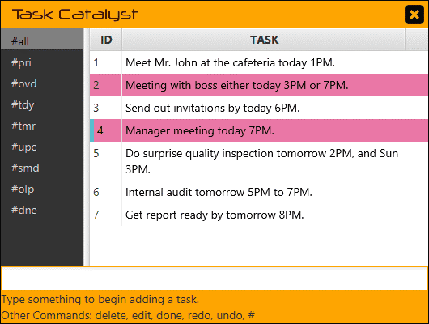
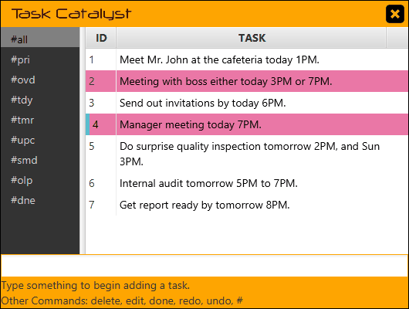
Software Features
Refine your plans.

Slide 24


Software Features
Keep only what you need.

Slide 25
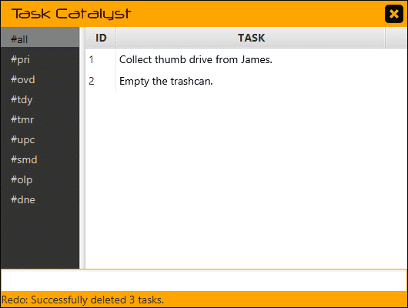
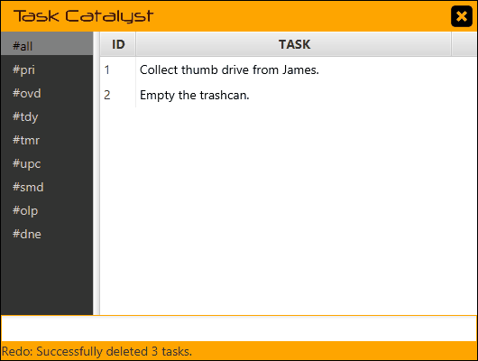
Software Features
Turn back time.
CTRL + Z: Undo
CTRL + Y: Redo

Slide 26
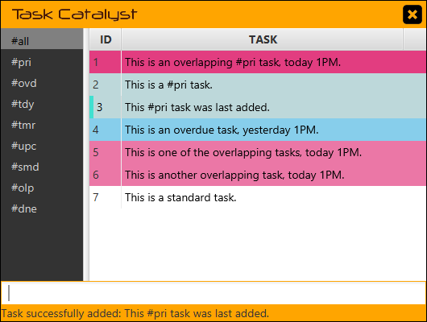
Software Features
Priority Tasks
Timed Tasks
Focus on the important.
Other Tasks

Slide 27
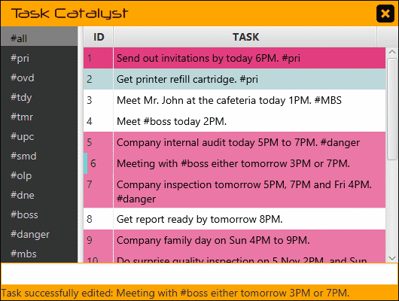

Software Features
Find what you need.

Slide 28
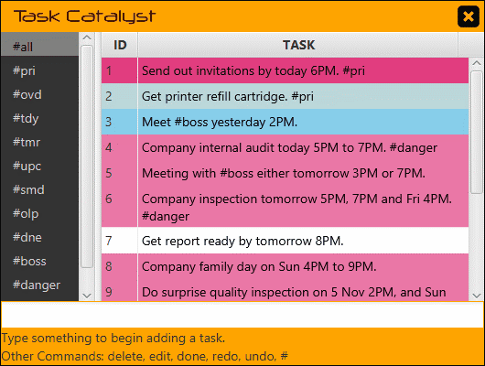

Software Features
All
Priority
Overdue
Today
Tomorrow
Upcoming
Keep organized.
Someday
Overlapping
Done

Slide 29
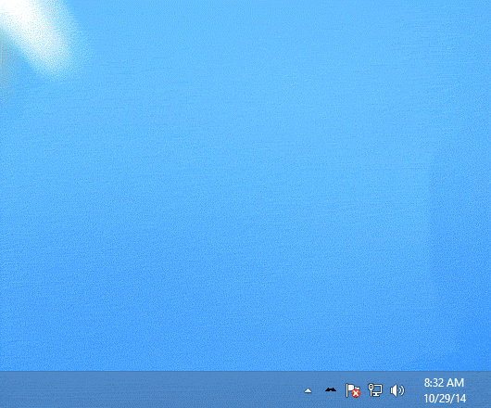
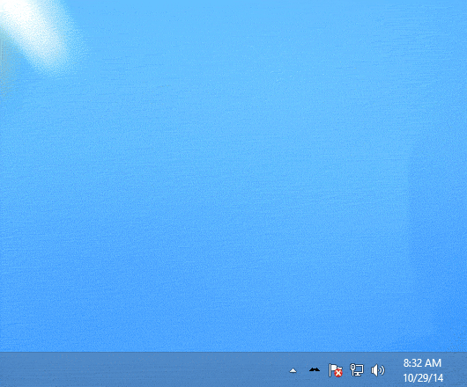
Software Features
Always ready for you.
CTRL + M : Minimize/Maximize
CTRL + E : Exit

Slide 30
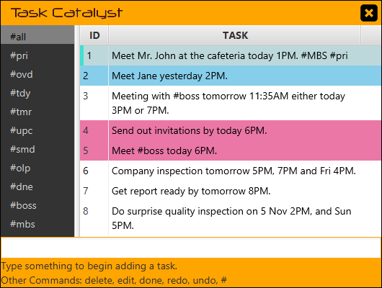
Software Features
Keep things in view.
Never miss a deadline.
Remember every single date.
Know how long it takes.
Simplify the complex.
Focus on the task.
Find the right words.
Stay current.
Get things done.
One thing at a time.
Make smart decisions.
Refine your plans.
Keep only what you need.
Turn back time.
Focus on the important.
Find what you need.
Keep organized.
Always ready for you.

Slide 31
SOFTWARE DEMONSTRATION

